Slide 1

Web Application Development
COMP-229

Slide 2
Adding a React Frontend to Complete MERN
A web application is incomplete without a frontend. It is the part that users interact with and it is crucial to any web experience.
we will use React to add an interactive user interface to the basic user and auth features that have been implemented for the backend of the MERN skeleton application, which we started building.
This functional frontend will add React components that connect to the backend API and allow users to navigate seamlessly within the application based on authorization.

Slide 3
By the end of this chapter, you will have learned how to easily integrate a React client-side with a Node-Express-MongoDB server-side to make a full-stack web application.

Slide 4
Objectives
Frontend features of the skeleton
Setting up development with React, React Router, and Material-UI
Rendering a home page built with React

Slide 5
Defining the skeleton application frontend
In order to fully implement the skeleton application features we discussed Building a Backend with MongoDB, Express, and Node, we will add the following user interface components to our base application:

Slide 6
Home page: A view that renders at the root URL to welcome users to the web application.
Sign-up page: A view with a form for user sign-up, allowing new users to create a user account and redirecting them to a sign-in page when successfully created.
Sign-in page: A view with a sign-in form that allows existing users to sign in so they have access to protected views and actions.
User list page: A view that fetches and shows a list of all the users in the database, and also links to individual user profiles.

Slide 7
Profile page: A component that fetches and displays an individual user's information.
This is only accessible by signed-in users and also contains edit and delete options, which are only visible if the signed-in user is looking at their own profile.
Edit profile page: A form that fetches the user's information to prefill the form fields.
This allows the user to edit the information and this form is accessible only if the logged-in user is trying to edit their own profile.
Delete user component: An option that allows the signed-in user to delete their own profile after confirming their intent.

Slide 8
Menu navigation bar: A component that lists all the available and relevant views to the user, and also helps to indicate the user's current location in the application.
The following React component tree diagram shows all the React components we will develop to build out the views for this base application:

Slide 9
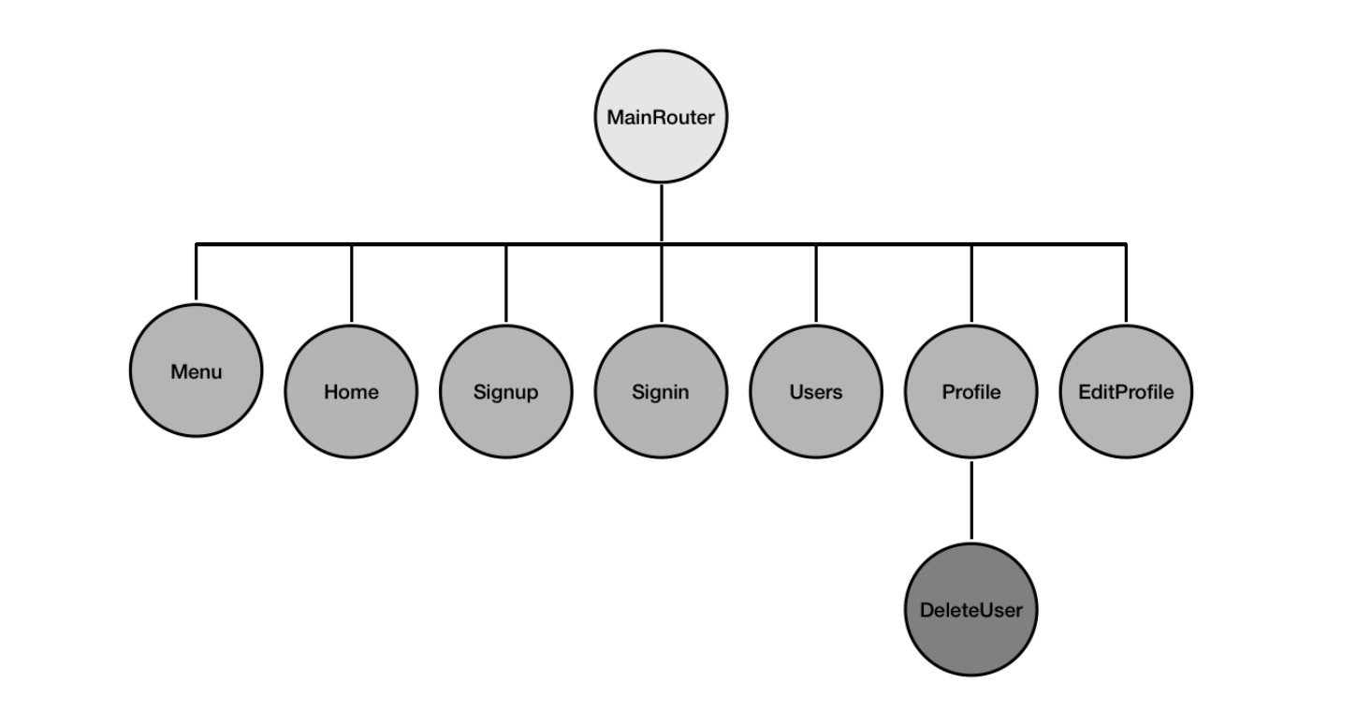

Slide 10
MainRouter will be the main React component. This contains all the other custom
React views in the application. Home, Signup, Signin, Users, Profile,and EditProfile will render at individual routes declared with React Router, whereas the Menu component will render across all these views.
DeleteUser will be a part of the Profile view.

Slide 11
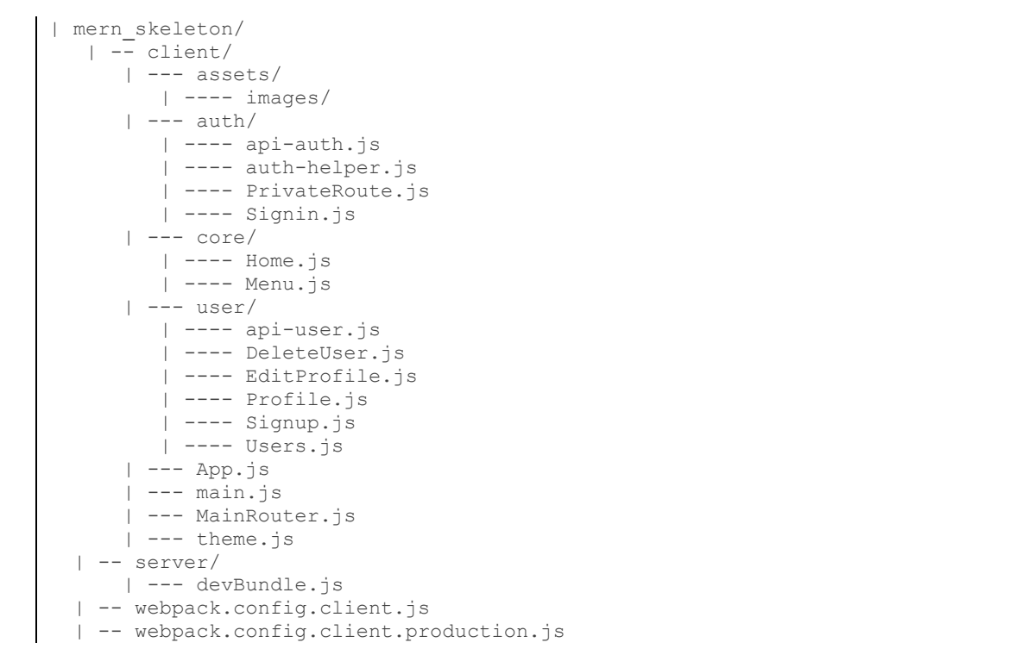
Folder and file structure
The following folder structure shows the new folders and files to be added to the skeleton project we started implementing previously in order to complete it with a React frontend:

Slide 12
The client folder will contain the React components, helpers, and frontend assets, such as images and CSS.
Besides this folder and the Webpack configuration files
for compiling and bundling the client code, we will also modify some of the other existing files to finish up the integration of the complete skeleton application in
Before we start implementing the specific frontend features, we need to get set up for React development by installing the necessary modules and adding configuration to compile, bundle, and load the React views.

Slide 13
Setting up for React development
Before we can start developing with React in our existing skeleton codebase, we need to
add configuration to compile and bundle the frontend code,
add the React- related dependencies that are necessary to build the interactive interface, and tie this all together in the MERN development flow.
To achieve this, we will add frontend configuration for Babel, Webpack, and React
Hot Loader to compile, bundle, and hot reload the code.
Next, we will modify the server code to initiate code bundling for both the frontend and backend in one
command to make the development flow simple.

Slide 14
Then, we will update the code further so that it serves the bundled code from the server when the application runs in the browser.
Finally, we will finish setting up by installing the React dependencies that are necessary to start implementing the frontend.

Slide 15
Configuring Babel
Babel
To compile React, first, install the Babel React preset module as a development dependency by running the following command from the command line i.e root or terminal if you do not have the .babelrc file:
yarn add --dev @babel/preset-react
Then, update .babelrc with the following code. This will include the module and also configure the react-hot-loader Babel plugin as required for the react-hot- loader module.

Slide 16
updated .babelrc
mern-skeleton/.babelrc:
{
"presets": [
["@babel/preset-env",
{
"targets": {
"node": "current"
}
}
],
"@babel/preset-react"
],
"plugins": [
"react-hot-loader/babel"
]
}

Slide 17
Loading bundled frontend code
The frontend views that we will see rendered in the browser will load from the bundled files in the dist folder.
For it to be possible to add these bundled files to the HTML view containing our frontend, we need to configure the Express app so that it serves static files, which are files that aren't generated dynamically by server-side code.

Slide 18
Server/dist folder
Create a dist folder in the server
we will configure the Express server app so that it serves the static files from this dist folder.
This will ensure that the bundled React code can be loaded in the browser.
Create a folder called dist in the server folder

Slide 19
Serving static files with Express
To ensure that the Express server properly handles the requests to static files such as CSS files, images, or the bundled client-side JS, we will configure it so that it serves static files from the dist folder by adding the following configuration in express.js.
mern-skeleton/server/express.js:
import path from 'path'
const CURRENT_WORKING_DIR = process.cwd()
app.use('/dist', express.static(path.join(CURRENT_WORKING_DIR, 'dist')))

Slide 20
Updated express.js file.
import express from 'express'
import bodyParser from 'body-parser'
import cookieParser from 'cookie-parser'
import compress from 'compression'
import cors from 'cors'
import helmet from 'helmet'
import Template from './../template.js'
import userRoutes from './routes/user.routes.js'
//import devBundle from './devBundle'
import path from 'path'
const app = express()
const CURRENT_WORKING_DIR = process.cwd()
//devBundle.compile(app)
//...
app.get('/', (req, res) => {
res.status(200).send(Template())
})
//...
app.use('/dist', express.static(path.join(CURRENT_WORKING_DIR, 'dist')))
app.use(express.json());
app.use(express.urlencoded({ extended: true }));
app.use('/', userRoutes)
app.use(bodyParser.json())
app.use(bodyParser.urlencoded({ extended: true }))
app.use(cookieParser())
app.use(compress())
app.use(helmet())
app.use(cors())
export default app

Slide 21
With this configuration in place, when the Express app receives a request at a route starting with /dist, it will know to look for the requested static resource in the dist folder before returning the resource in the response.
Now, we can load the bundled files from the dist folder in the frontend.
Create a file called bundle.js in the dist folder

Slide 22
Updating the template to load a bundled script
To add the bundled frontend code in the HTML to render our React frontend, we will update the template.js file so that it adds the script file from the dist folder to the end of the <body> tag.
mern-skeleton/template.js:
...
<body>
<div id="root">Hello World</div>
<script type="text/javascript“ src="/dist/bundle.js"></script>
</body>

Slide 23
This script tag will load our React frontend code in the browser when we visit the root URL '/' with the server running.
We are ready to see this in action and can start installing the dependencies that will add the React views.

Slide 24
Adding React dependencies
The frontend views in our skeleton application will primarily be implemented using React.
In addition, to enable client-side routing, we will use React Router, and to enhance the user experience with a sleek look and feel, we will use Material-UI.
To add these libraries, we will install the following modules in this section:
Core React modules: react and react-dom
React Router modules: react-router and react-router-dom
Material-UI modules: @material-ui/core and @material-ui/icons

Slide 25
React
To start writing the React component code, we will need to install the following modules as regular dependencies: (cd client)
yarn add react react-dom
These are the core React library modules that are necessary for implementing the React-based web frontend.
With other additional modules, we will add more functionality on top of React.

Slide 26
React Router
React Router provides a collection of navigational components that enable routing on the frontend for React applications. (cd client)
We will add the following React Router modules:
yarn add react-router react-router-dom
These modules will let us utilize declarative routing and have bookmarkable URL routes in the frontend.

Slide 27
Material-UI
In order to keep the UI in our MERN applications sleek without delving too much into UI design and implementation, we will utilize the Material-UI library.
It provides ready to use and customizable React components that implement Google's material design. To start using Material-UI components to make the frontend, (cd client) we need to install the following modules:
yarn add @material-ui/core @material-ui/icons

Slide 28
At the time of writing, the latest version of Material-UI is 4.9.8. It is recommended that you install this exact version in order to ensure the code for the example projects does not break.
To add the Roboto fonts that are recommended by Material-UI and to use the Material-UI icons, we will add the relevant style links into
the template.js file, in the HTML document's <head> section:
<link rel="stylesheet"
href="https://fonts.googleapis.com/css?family=Roboto:100,300,400">
<link href="https://fonts.googleapis.com/icon?family=Material+Icons"
rel="stylesheet">

Slide 29
Updated template.js
export default () => {
return `<!doctype html>
<html lang="en">
<head>
<meta charset="utf-8">
<title>MERN Skeleton</title>
<link rel="stylesheet"
href="https://fonts.googleapis.com/css?family=Roboto:100,300,400">
<link href="https://fonts.googleapis.com/icon?family=Material+Icons"
rel="stylesheet">
</head>
<body>
<div id="root">Hello World</div>
<script type="text/javascript" src="/dist/bundle.js"></script>
</body>
</html>`
}

Slide 30
With the development configuration all set up and the necessary React modules added to the code base, we can now implement the custom React components, starting with a home page.
This should load up as the first view of the complete application.

Slide 31
Rendering a home page view
To demonstrate how to implement a functional frontend for this MERN skeleton, we will start by detailing how to render a simple home page at the root route of the application, before covering backend API integration, user auth integration, and implementing the other view components
The process of implementing and rendering a working Home component at the root route will also expose the basic structure of the frontend code in the skeleton.
We will start with the top-level entry component that houses the whole React app and renders the main router component, which links all the React components in the application.

Slide 32
In the following sections, we will begin implementing the React frontend.
First, we will add the root React component, which is integrated with React Router and Material-UI and configured for hot reloading.
We will also learn how to customize the Material-UI theme and make the theme available to all our components.
Finally, we will implement and load the React component representing the home page, in turn demonstrating how to add and render React views in this application

Slide 33
Entry point at main.jsx
The client/src/main.jsx file in the client folder will be the entry point to render the complete React app.
In client/src/main.jsx, we import the root or top-level React component that will contain the whole frontend and render it to the div element with the 'root' ID specified in the HTML document in template.js.

Slide 34
mern-skeleton/client/src/main.jsx:
import React from 'react'
import { render } from 'react-dom'
import App from './App'
render(<App/>, document.getElementById('root’))
Here, the top-level root React component is the App component and it is being rendered in the HTML.
The App component is defined in client/src/App.jsx

Slide 35
Updated mern-skeleton/client/src/main.jsx:
import React from 'react'
import App from './App.jsx'
import { createRoot } from 'react-dom/client';
const container = document.getElementById('root');
const root = createRoot(container);
root.render(<App tab="home" />)

Slide 36
Root React component
The top-level React component that will contain all the components for the application's frontend is defined in the client/src/App.jsx file.
In this file, we configure the React app so that it renders the view components with a customized Material- UI theme, enables frontend routing, and ensures that the React Hot Loader can instantly load changes as we develop the components.
In the following sections, we will add code to customize the theme, make this theme and React Router capabilities available to our React components, and configure the root component for hot reloading.

Slide 37
Customizing the Material-UI theme
The Material-UI theme can be easily customized using the ThemeProvider component.
It can also be used to configure the custom values of theme variables in createMuiTheme() or createTheme.
We will define a custom theme for the skeleton application in client/theme.jsx using createMuiTheme or createTheme, and then export it so that it can be used in the App component.

Slide 38
mern-skeleton/client/theme.jsx:
import { createTheme } from '@material-ui/core/styles'
import { pink } from '@material-ui/core/colors'
const theme = createTheme({
typography: {
useNextVariants: true,
},
palette: {
primary: {
light: '#5c67a3',
main: '#3f4771',
dark: '#2e355b',
contrastText: '#fff',
},
secondary: {
light: '#ff79b0',
main: '#ff4081',
dark: '#c60055',
contrastText: '#000',
},
openTitle: '#3f4771',
protectedTitle: pink['400'],
type: 'light'
}
})
export default theme

Slide 39
Wrapping the root component with ThemeProvider and BrowserRouter
The custom React components that we will create to make up the user interface will be accessed with the frontend routes specified in the MainRouter component.
Essentially, this component houses all the custom views that have been developed for the application and needs to be given the theme values and routing features.
This component will be our core component in the root App component, which is defined in the following code.

Slide 40
Updated mern-skeleton/client/src/App.jsx:
import React from 'react';
import { BrowserRouter as Router } from 'react-router-dom';
import { ThemeProvider } from '@material-ui/styles';
import MainRouter from '../MainRouter';
import theme from '../theme';
//import { hot } from 'react-hot-loader'
const App = () => {
return (
<Router>
<ThemeProvider theme={theme}>
<MainRouter />
</ThemeProvider>
</Router>
);
};
export default App;

Slide 41
When defining this root component in App.jsx, we wrap the MainRouter component with ThemeProvider, which gives it access to the Material-UI theme, and BrowserRouter, which enables frontend routing with React Router.
The custom theme variables we defined previously are passed as a prop to ThemeProvider, making the theme available in all our custom React components.
Finally, in the App.jsx file, we need to export this App component so that it can be imported and used in main.jsx.

Slide 42
Adding a home route to MainRouter.jsx
The MainRouter.jsx code will help render our custom React components with respect to the routes or locations in the application.
In this first version, we will only add the root route for rendering the Home component.
Create a file called MainRouter.jsx in the client folder as follows:

Slide 43
mern-skeleton/client/MainRouter.jsx
import React from 'react'
import {Route, Routes} from 'react-router-dom'
import Home from './core/Home'
const MainRouter = () => {
return ( <div>
<Routes>
<Route exact path="/" element={<Home />}/>
</Routes>
</div>
)
}
export default MainRouter

Slide 44
The Home component, which we added this route for in MainRouter, needs to be defined and exported

Slide 45
The Home component
The Home component will be the React component containing the home page view of the skeleton application.
It will be rendered in the browser when the user visits the root route, and we will compose it with Material-UI components.
The following screenshot shows the Home component, as well as the Menu component, which will be implemented later in this chapter as an individual component that provides navigation across the application:

Slide 46
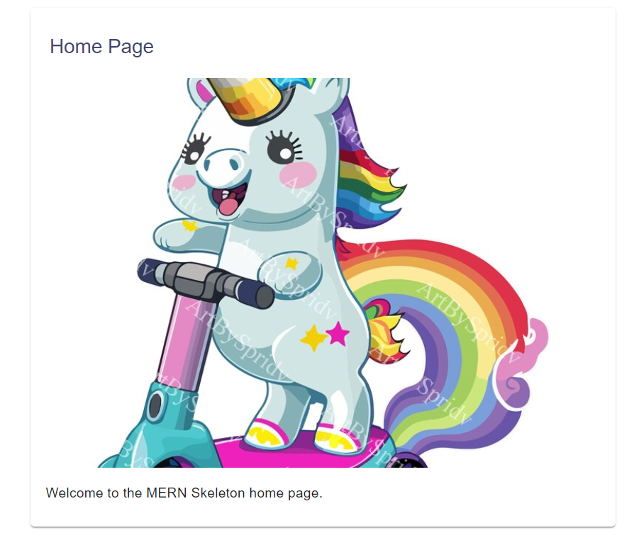

Slide 47
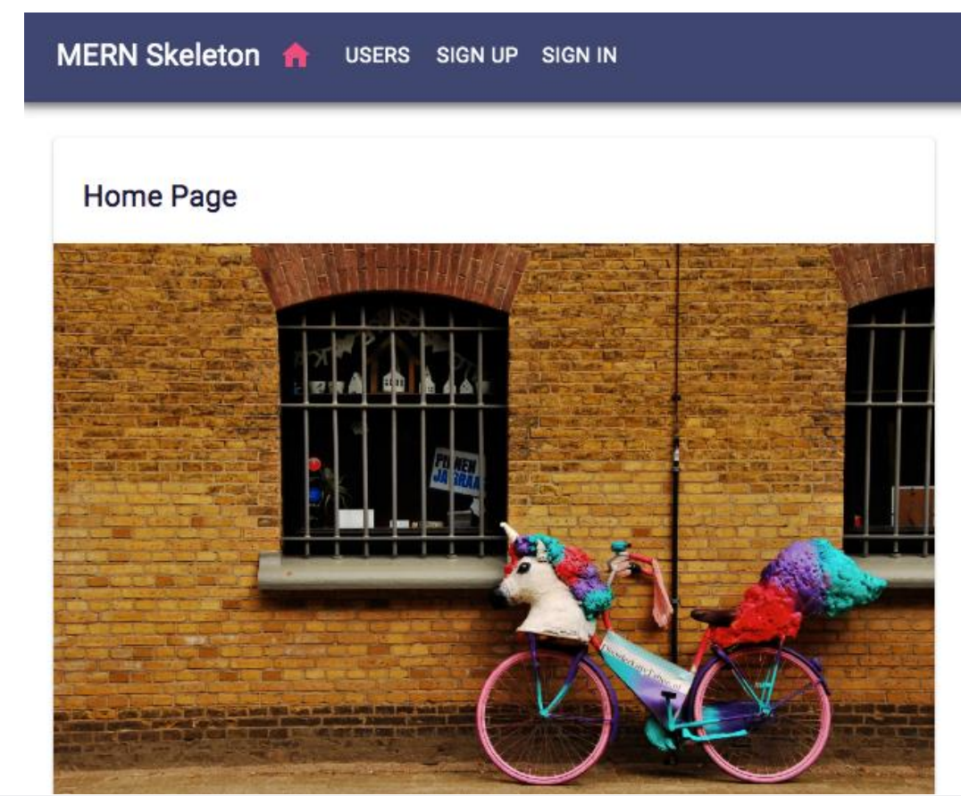

Slide 48
The Home component and other view components that will be rendered in the browser for the user to interact with will follow a common code structure that contains the following parts in the given order:
Imports of libraries, modules, and files needed to construct the component
Style declarations to define the specific CSS styles for the component elements
A function that defines the React component

Slide 49
as we develop new React components representing the
frontend views, we will focus mainly on the React component definition part.
But for our first implementation, we will elaborate on all these parts to introduce the necessary structure.

Slide 50
Imports
For each React component implementation, we need to import the libraries, modules, and files being used in the implementation code.
The component file will start with imports from React, Material-UI, React Router modules, images, CSS, API fetch, and the auth helpers from our code, as required by the specific component.
Create a folder called core in the client folder then create a file called Home.jsx
In the client folder create a folder called assets, in the assets folder create another folder called images. In the images folder,
Add the unicornbike.jpg image or any other image
For example, for the Home component code in Home.jsx, we use the following imports.

Slide 51
mern-skeleton/client/core/Home.jsx:
import React from 'react'
import { makeStyles } from '@material-ui/core/styles'
import Card from '@material-ui/core/Card'
import CardContent from '@material-ui/core/CardContent'
import CardMedia from '@material-ui/core/CardMedia'
import Typography from '@material-ui/core/Typography'
import unicornbikeImg from './../assets/images/unicornbike.jpg'

Slide 52
The image file is kept in the client/assets/images/ folder and is imported so that it can be added to the Home component.
These imports will help us build the component and also define the styles to be used in the component.

Slide 53
Style declarations
After the imports, we will define the CSS styles that are required to style the elements in the component by utilizing the Material-UI theme variables and makeStyles, which is a custom React hook API provided by Material-UI.
Hooks are new to React. Hooks are functions that make it possible to use React state and life cycle features in function components, without having to write a class to define the component.
React provides some built-in hooks, but we can also build custom hooks as needed to reuse stateful behavior across different components.
To learn more about React Hooks, visit reactjs.org/docs/hooks-intro.html.
OR
https://react.dev/blog/2023/03/16/introducing-react-dev

Slide 54
Updated mern-skeleton/client/core/Home.jsx
import React from 'react';
import { makeStyles } from '@material-ui/core/styles';
import Card from '@material-ui/core/Card';
import CardContent from '@material-ui/core/CardContent';
import CardMedia from '@material-ui/core/CardMedia';
import Typography from '@material-ui/core/Typography';
import unicornbikeImg from './../assets/images/unicornbikeImg.jpg';
const useStyles = makeStyles(theme => ({
card: {
maxWidth: 600,
margin: 'auto',
marginTop: theme.spacing(5),
},
title: {
padding: theme.spacing(3, 2.5, 2),
color: theme.palette.openTitle,
},
media: {
minHeight: 400,
},
}));
export default function Home(){
const classes = useStyles()
return (
<Card className={classes.card}>
<Typography variant="h6" className={classes.title}>Home Page</Typography>
<CardMedia className={classes.media}
image={unicornbikeImg} title="Unicorn Bicycle"/>
<CardContent>
<Typography variant="body2" component="p">
Welcome to the MERN Skeleton home page.
</Typography>
</CardContent>
</Card>
)
}

Slide 55
The JSS style objects defined here will be injected into the component using the hook returned by makeStyles.
The makeStyles hook API takes a function as an argument and gives access to our custom theme variables, which we can use when defining the styles.
Material-UI uses JSS, which is a CSS-in-JS styling solution for adding styles to components. JSS uses JavaScript as a language to describe styles.
We will not cover CSS and styling implementations in detail. It will mostly rely on the default look and feel of Material-UI components.

Slide 56
To learn more about JSS, visit http://cssinjs.org/?v=v9.8.1
For examples of how to customize the Material-UI component styles, check out the Material-UI documentation at https://material-ui.com/
We can use these generated styles to style the elements in the component, as shown in the following Home component definition.

Slide 57
Component definition
While writing the function to define the component, we will compose the content and behavior of the component.
The Home component will contain a Material- UI Card with a headline, an image, and a caption, all styled with the styles we defined previously and returned by calling the useStyles() hook.

Slide 58
In the preceding code, we defined and exported a function component named Home.
The exported component can now be used for composition within other components.
We already imported this Home component in a route in the MainRouter component, as we discussed earlier.
we will define all our React components as functional components.
We will utilize React Hooks, which is a new addition to React, to add state and life cycle features, instead of using class definitions to achieve the same.
The other view components to be implemented in our MERN applications will adhere to the same structure.

Slide 59
we will focus mainly on the component definition, highlighting the unique aspects of the implemented component.
We are almost ready to run this code to render the home page component in the frontend.

Slide 60
Updated index.html
<!DOCTYPE html>
<html lang="en">
<head>
<meta charset="UTF-8" />
<link rel="icon" type="image/svg+xml" href="/favicon.svg" />
<meta name="viewport" content="width=device-width, initial-scale=1.0" />
<title>Vite App</title>
</head>
<body>
<div id="root">Welcome to Frontend
</div>
<script type="module">
import RefreshRuntime from "http://localhost:5173/@react-refresh";
RefreshRuntime.injectIntoGlobalHook(window);
window.$RefreshReg$ = () => {};
window.$RefreshSig$ = () => (type) => type;
window.__vite_plugin_react_preamble_installed__ = true;
</script>
<script type="module" src="http://localhost:5173/src/main.jsx"></script>
</body>
</html>

Slide 61
Updated index.html
<!DOCTYPE html>
<html lang="en">
<head>
<meta charset="UTF-8" />
<link rel="icon" type="image/svg+xml" href="/favicon.svg" />
<meta name="viewport" content="width=device-width, initial-scale=1.0" />
<title>Vite App</title>
</head>
<body>
<div id="root">
<script type="module" src="http://localhost:5173/src/main.jsx"></script>
</div>
</body>
</html>

Slide 62
Updated client/src/App.jsx
import React from 'react';
import { BrowserRouter as Router } from 'react-router-dom';
import { ThemeProvider } from '@material-ui/styles';
import MainRouter from '../MainRouter';
import theme from '../theme';
const App = () => {
return (
<Router>
<ThemeProvider theme={theme}>
<MainRouter />
</ThemeProvider>
</Router>
);
};
export default App;

Slide 63
Updated main.jsx
import React from 'react'
import App from './App.jsx'
import { createRoot } from 'react-dom/client';
const container = document.getElementById('root');
const root = createRoot(container);
root.render(<App tab="home" />)

Slide 64
Updated MainRouter.jsx
import React from 'react'
import {Route, Routes} from 'react-router-dom'
import Home from './core/Home'
const MainRouter = () => {
return ( <div>
<Routes>
<Route exact path="/" element={<Home />}/>
</Routes>
</div>
)
}
export default MainRouter

Slide 65
Running and opening in the browser
The client code up to this point can be run so that we can view the Home component in the browser at the root URL.
To run the application, use the following command:
yarn development
Then, open the root URL (http://localhost:3000) in the browser and the client URL (http://localhost:5173/) to see the Home component.
The Home component we've developed in this section is a basic view component without interactive features and does not require the use of the backend APIs for user CRUD or auth.
However, the remaining view components for our skeleton frontend will need the backend APIs and auth so we will look at how to integrate it.

